Slide 1
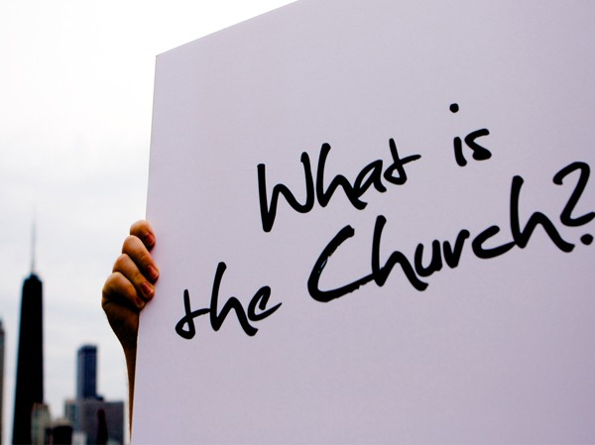
Notes:
If we’re going to see where Christians went wrong over the last 2000 years to get us to the point today where we have over 7000 denominations, it would be beneficial to first learn what the church of the New Testament actually is. There is only one church in the New Testament and that is the church that Jesus built. It is the only church in which we will find salvation, the only church which will endure forever. The Lord’s church has a specific identity that can be seen by searching the pages of scripture itself. Through understanding the identity of the New Testament church, we can begin to weed out denominational churches that are not found in scripture.

Slide 2
The Church
Matt 16:18 – “I also say to you that you are Peter, and upon this rock I will build My church; and the gates of Hades will not overpower it.”
Acts 8:3 – “But Saul began ravaging the church, entering house after house, and dragging off men and women, he would put them in prison.”
Col 1:13 – “For He rescued us from the domain of darkness, and transferred us to the kingdom of His beloved Son, in whom we have redemption, the forgiveness of sins.”
Notes:
Often when we use the word church, we do so to refer to a building, the place in which we meet regularly for worship and bible study. However, this is neither the meaning or the correct usage of the word. “Church” comes from the Greek word “Ekklesia” which simply means “called out of”. The word refers to a group of people who have been called out of something. So the church, which is begun by Christ, are simply men and women whom Paul says in Col 1:13 have been rescued from the domain of darkness and transferred to His kingdom. This is the scriptural definition of the word “church” that understanding this meaning is the first step to identifying it.

Slide 3
The Church
Called out by who?
Phil 3:13-14 – “¹³Brethren, I do not regard myself as having laid hold of it yet; but one thing I do: forgetting what lies behind and reaching forward to what lies ahead, ¹⁴I press on toward the goal for the prize of the upward call of God in Christ Jesus.”
Called to be what?
Eph 5:25-27 – “²⁵Husbands, love your wives, just as Christ also loved the church and gave Himself up for her, ²⁶so that He might sanctify her, having cleansed her by the washing of water with the word, ²⁷that He might present to Himself the church in all her glory, having no spot or wrinkle or any such thing; but that she would be holy and blameless.”
Notes:
This calling is done by no one but God Himself, who desperately desires to have a relationship with mankind. God ultimately initiated this calling, though, through Jesus Christ and the sacrifice He made on our behalf so that we can have our sins forgiven. The precious shed blood of Jesus Christ is such an act of compelling love, that it will drive all those with honest sincere hearts to Him. This is the means by which a holy God can have a relationship with sinful people, that by the atoning sacrifice of His Son, our sins can be forgiven and we can stand justified in Hs sight.
By this calling, God’s aim for His church is that we would holy and blameless. Our job on this earth is to keep ourselves pure and clean from the defilements of the world so that we can living godly in this perverse culture and inspire others toward the same calling. Jesus is our ultimate example and lead toward this goal, as He not only sacrificed Himself on the cross, He also sacrificed Himself in His daily life by resisting temptation for our sake and therefore remaining qualified to be a sin offering in our place.

Slide 4
The Church
Called through what?
2 Thes 2:14 – “It was for this He called you through our gospel, that you may gain the glory of our Lord Jesus Christ.”
2 Thes 1:7b-8 – “…the Lord Jesus will be revealed from heaven with His mighty angels in flaming fire, dealing out retribution to those who do not know God and to those who do not obey the gospel of our Lord Jesus.”
1 Pet 4:17 – “For it is time for judgment to begin with the household of God; and if it begins with us first, what will be the outcome for those who do not obey the gospel of God?”
Notes:
Since Jesus is 2000 years from removed from His physical ministry on Earth, God saw to it that we would learn about His life, death, and resurrection through the written word. It is therefore through the gospel that we learn about Him. The gospel is the “glad tidings” or “good news” about Jesus Christ that contains facts about His life, death, burial, and resurrection. But it is not enough to merely believe the story because the bible also says we must obey this gospel. And those who don’t obey the gospel will be dealt retribution when Jesus returns. Therefore the gospel is not just the story of Jesus Christ but contains commands that we must obey if we are going to be saved.

Slide 5
The Church
What Is obeying the gospel?
Hear
John 10:27 – “My sheep hear My voice, and I know them, and they follow Me”
Believe
John 8:24b – “Unless you believe that I am He, you will die in your sins.”
Repent
Luke 13:3b – “Unless you repent, you will all likewise perish.”
Confess
Matt 10:32– “Therefore everyone who confesses Me before men, I will also confess him before My Father who is in heaven.”
Be Baptized
Mark 16:16a – “He who has believed and has been baptized shall be saved.”
Stay Faithful
John 8:31b – “If you continue in My word, then you are truly disciples of Mine.”
Notes:
To know what we must do to be saved, which is called “obeying the gospel”, we will go to the words of Jesus Christ Himself.
We must first hear the word. Some will claim they were some mystic “baptizing” apart from biblical teaching. This is impossible as Rom 10:17 tells us that faith comes by hearing, and this hearing must come from the word of God. Hearing the word of God is the first step toward obeying the gospel.
Once we have heard the word of God, we are face with the choice of whether we believe it. Jesus said that unless we believe that He is (the Son of God), we will die in our sins. This faith involves conviction, trust, and submission if it is to be true biblical faith.
We must repent of our sins. This is the idea of renouncing our former life, feeling sorrow for the sins we’ve committed, and resolving to no longer live for ourselves but to live for Jesus Christ. The purpose of the gospel is to change us – and we must change!
We must be willing to confess Jesus before men if we are to expect Jesus will confess us before His Father. While this is a verbal confession, it is also a commitment that should carry on through our lives in the way that we have now chosen to live.
The bible teaches that the point of forgiveness occurs when we are baptized in water – this is when our sins are washed away. This is not because there is power in the water; the power belongs to God according to our faith.
Finally, the bible is clear that we must continue being faithful to Jesus and His word. It cannot be that we obey the gospel and then continue to love how we’ve always lived. The gospel is designed to change us, and change us it must. It is possible to fall from grace.

Slide 6
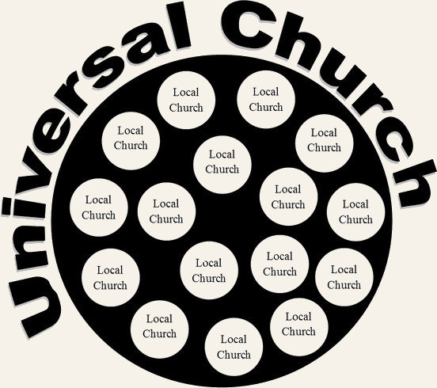
The Church
Universal
Eph 1:22-23– “And He put all things in subjection under His feet, and gave Him as head over all things to the church, which is His body, the fullness of Him who fills all in all.”
Eph 4:4 – “There is one body and one Spirit, just as also you were called in one hope of your calling”
Local
1 Thes 1:1 – “Paul and Silvanus and Timothy, to the church of the Thessalonians in God the Father and the Lord Jesus Christ: Grace to you and peace.”
2 Cor 1:1 – “Paul, an apostle of Christ Jesus by the will of God, and Timothy our brother, to the church of God which is at Corinth with all the saints who are throughout Achaia
Notes:
It is important to understand that the bible uses the word “church” in two ways.
First, there is the “universal” sense. This church contains all men and women, past, present, and future, who are saved. When we obey the gospel, we are added to the universal church to join the collective body of all saved people from every age. The church is also called “the body” in scripture and Eph 4:4 says there is only one body. Therefore there is only one universal church and we need to make sure we have satisfied the conditions to join it because this is the only body that Christ is the Savior of (Eph 5:23).
Second, there is the “local” sense. While there is only one universal church, there are many local churches. Local churches pop up in cities and communities whenever Christians decide they want to fellowship with one another in the worship and work of the church as they model themselves after the organizational structure the NT teaches. While every is added to the universal church when they obey the gospel, a person must approach Christians of a local church and express a desire to join – and desire it he must! God had designed the local church to be the headquarters where his work is performed by Christians in their respective communities.

Slide 7
The Word of God
1 Tim 3:15 – “But in case I am delayed, I write so that you will know how one ought to conduct himself in the household of God, which is the church of the living God, the pillar and support of the truth.”
John 17:17 – “Sanctify them in the truth; Your word is truth.”
Notes:
One of the primary purposes of the local church is to assure that we are upholding the truth of God as it has been revealed in His word. Paul told Timothy that the church is to be the pillar and support of the truth. Jesus says that the truth is His word. Therefore, any church that is aspiring to be the church Jesus built must uphold the bible as the source of all truth and divine revelation. If a church is not staying true to the bible in its entirety, it cannot be identified as the New Testament church.
There are some denominations that put very little emphasis on the bible. The sermons are watered down and the “bible” classes rarely, if ever, use scripture. Other denominations claim that the common man cannot understand scripture and we must therefore put out trust in the interpretation of our leaders. If you know of any such denomination, you ca be sure this is not the church that Jesus built as He Himself used the word of God constantly throughout His ministry to answer questions and to thwart the temptations of Satan himself. Any church aspiring to be the church that Jesus built must have the bible as its blueprint and final authority for everything it is and everything it does.

Slide 8
The Word of God
Authority
John 12:49-50 – “For I did not speak on My own initiative, but the Father Himself who sent Me has given Me a commandment as to what to say and what to speak. I know that His commandment is eternal life; therefore the things I speak, I speak just as the Father has told Me.”
John 16:13 – “But when He, the Spirit of truth, comes, He will guide you into all the truth; for He will not speak on His own initiative, but whatever He hears, He will speak; and He will disclose to you what is to come.”
Notes:
To understand why the bible must be the final authority for everything a church is and everything it does, we should consider how Jesus and the Holy Spirit worked during the first century. In John 12:49-50, Jesus made it clear to those seeking Him that He did not come to the Earth to speak of His own initiative. He only came to do what His Father told Him to do. He only speaks as His Father speaks. In other words, Jesus is providing Christians with a great example of how we must be. The Holy Spirit likewise would not speak of His own initiative, but only what He heard from Jesus. If both Jesus and the Holy Spirit only spoke what was given to them from above, how much more should be careful not to act or speak beyond what God has authorized in His word?
Some denominations will take it upon themselves to add and take away from God’s word as it please them. We must be on guard against churches such as this.

Slide 9
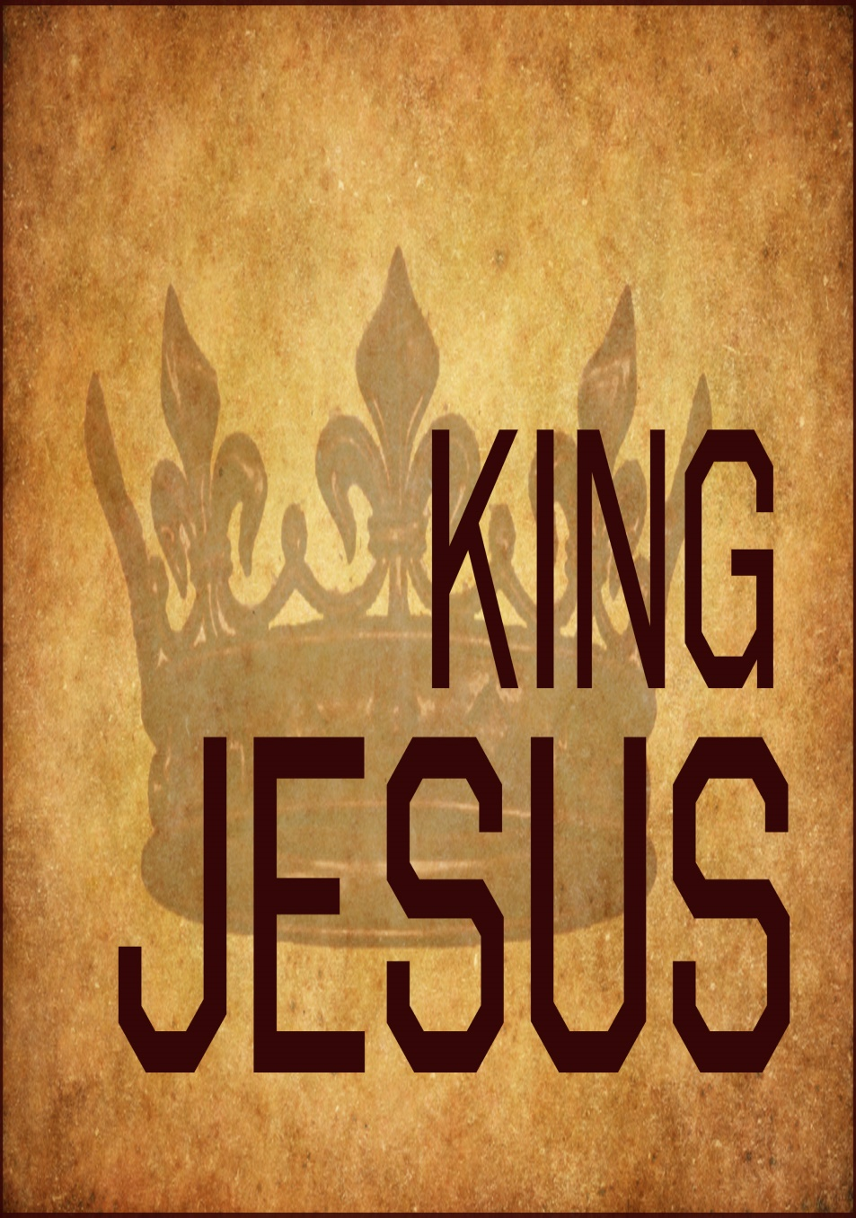
The Word of God
Jesus’ Authority
Matt 28:18 – “And Jesus came up and spoke to them, saying, ‘All authority has been given to Me in heaven and on earth.’”
John 13:20 – “Truly, truly, I say to you, he who receives whomever I send receives Me; and he who receives Me receives Him who sent Me.”
Luke 10:16 – “The one who listens to you listens to Me, and the one who rejects you rejects Me; and he who rejects Me rejects the One who sent Me.”
Acts 2:42 – “They were continually devoting themselves to the apostles’ teaching and to fellowship, to the breaking of bread and to prayer.”
Notes:
When Jesus died and was raised from the dead, God granted Him all authority in heaven and on earth (Matt 28:18). In other words, His will is that which we must obey and follow. But since He is not here, how can we know what His will is? He delegated His authority to those He would send after Him who were eye-witnesses of His death, burial, and resurrection. The word “apostle” means “one sent”, specifically a person who was sent with a message. Jesus appointed 12 men during His ministry to be His apostles by which the gospel would spread throughout the world. As John 13:20 and Luke 10:16 make very clear, those who receive them receive Jesus and those who receive Jesus receive them. Therefore Jesus applied equal authority to His apostles and what they would speak. And so when the first 3000 were baptized on Pentecost, we find they were devoting themselves to the apostles’ doctrine and teaching (Acts 2:42).

Slide 10
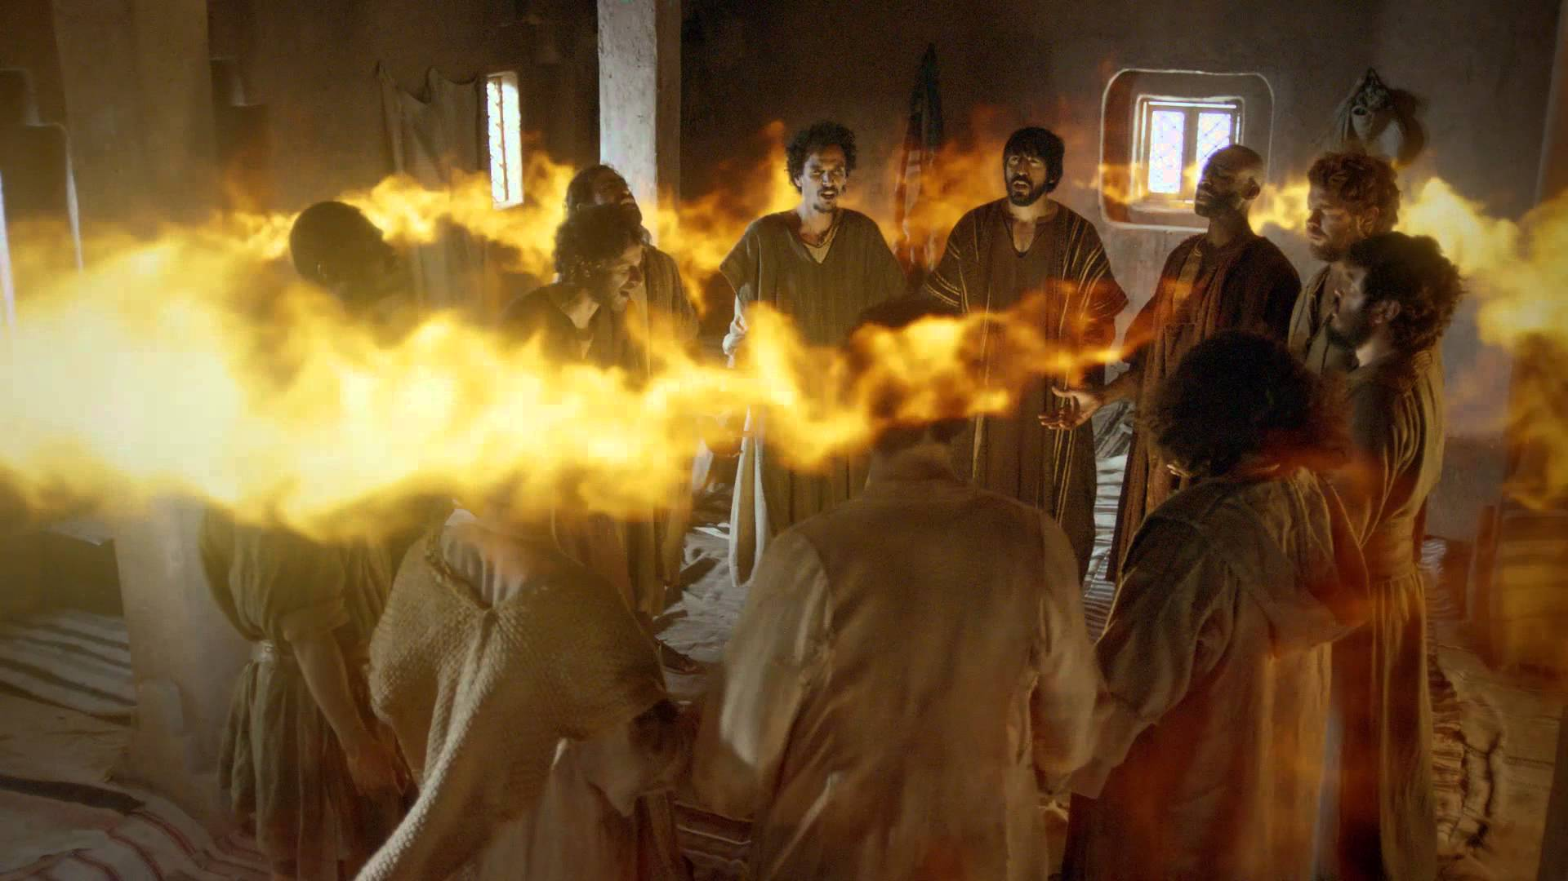
The Word of God
Apostles’ Authority
John 14:26 – “But the Helper, the Holy Spirit, whom the Father will send in My name, He will teach you all things, and bring to your remembrance all that I said to you.”
John 16:13 – “But when He, the Spirit of truth, comes, He will guide you into all the truth; for He will not speak on His own initiative, but whatever He hears, He will speak; and He will disclose to you what is to come.”
Acts 2:1-4 – “When the day of Pentecost had come, they were all together in one place. And suddenly there came from heaven a noise like a violent rushing wind, and it filled the whole house where they were sitting. And there appeared to them tongues as of fire distributing themselves, and they rested on each one of them. And they were all filled with the Holy Spirit and began to speak with other tongues, as the Spirit was giving them utterance.”
Notes:
What made the Apostles’ word so dependable? How would they know what Jesus wanted them to teach? How would they remember? Jesus provided them with divine assistance after He ascended to heaven in the Person of the Holy Spirit. The purpose of the baptism of the Holy Spirit upon the Apostles’ was to help them remember the things Jesus taught, to disclose to them things He had not yet taught them and that they were unable to handle while He was on Earth, and to help them in their ministry persuade others by miracles that accompanied their teaching. The Holy Spirit upon the Apostles is the assurance that the things they teach are actually the word of God. Therefore, the doctrine and teaching of the Apostles is not the word of man or of man’s opinions, but divinely inspired as if was coming directly from the mouth of Jesus.

Slide 11
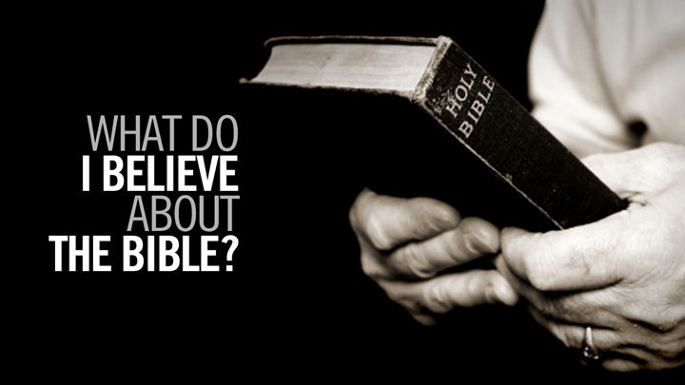
The Word of God
Scripture’s Authority
Eph 3:3-4 – “That by revelation there was made known to me the mystery, as I wrote before in brief. By referring to this, when you read you can understand my insight into the mystery of Christ.”
2 Tim 3:16-17 – “All Scripture is inspired by God and profitable for teaching, for reproof, for correction, for training in righteousness; so that the man of God may be adequate, equipped for every good work.”
Jude 3 – “Beloved, while I was making every effort to write you about our common salvation, I felt the necessity to write to you appealing that you contend earnestly for the faith which was once for all handed down to the saints.”
Notes:
But now that the Apostles are dead, how did they ensure that we would have their teaching? They simply wrote it down, through biographies of Christ and personal letters to churches and individuals. When they wrote it down, they did so in such a way that we can understand what they say (Eph 3:3-4). This is what we call scripture, and all scripture is inspired and able to provide us with what we need to understand and obey God’s will. The Apostles and Prophets were the last ones to record God’s word as Jude makes it very clear that this “faith” was handed down once and for all to the saints.
Therefore, we should be wary of denominations that claim the bible cannot be understood because Paul said differently. There are “some” things more difficult to understand, but not impossible to understand (2 Pet 3:16). Also, we should be wary of any denomination claiming new revelation from God that is not contained in scripture, whether they claim this new revelation is coming to them directly from he Holy Spirit or whether they claim this new revelation is contained in other scriptures.

Slide 12
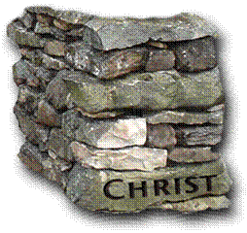
Organization
Universal Church Organization
Eph 2:19-22 – “So then you are no longer strangers and aliens, but you are fellow citizens with the saints, and are of God’s household, having been built on the foundation of the apostles and prophets, Christ Jesus Himself being the corner stone, in whom the whole building, being fitted together, is growing into a holy temple in the Lord, in whom you also are being built together into a dwelling of God in the Spirit.”
1 Pet 2:5 – “You also, as living stones, are being built up as a spiritual house for a holy priesthood, to offer up spiritual sacrifices acceptable to God through Jesus Christ.”
Notes:
One of the first attributes of a local church that confirms whether it is following the pattern of the New Testament is its organization. In fact, as we will study next week, this was one of the first steps that led to apostasy in the 2nd century. The organization of the universal church is very simple. In likening the church to the temple, Jesus is the cornerstone – that first stone that gets laid that determines how the rest of the temple will be oriented and upon which axis it will be built. From the cornerstone, the foundation is laid – this is the apostles and prophets as they were inspired by the Holy Spirit. Upon the foundation, we Christians, as living stones are being built. Every time a new Christian is added to the church, it becomes bigger and more glorious as it brings glory to God by its very construction.

Slide 13
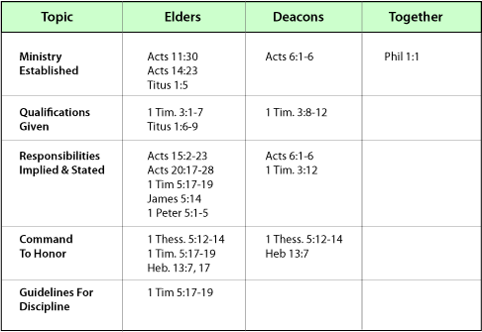
Organization
Local Church Organization
Phil 1:1 – “Paul and Timothy, bond-servants of Christ Jesus, to all the saints in Christ Jesus who are in Philippi, including the overseers and deacons.”
Elders
1 Tim 3:1-7; Tit 1:5-9; Acts 14:23; 1 Pet 5:1-5
Deacons
Acts 6:1-6; 1 Tim 3:8-12;
Notes:
However, the local church, in which God would have Christians to gather within for worship and work, has a very specific organization. In fact, conforming to the organization pattern of the New Testament church is imperative if we are to identify within all of this denominational confusion in our world. Within local churches, God would have elders to oversee the flock. These are men who are qualified according to 1 Tim 3:1-7 and Tit 1:5-9. Serving under the eldership are deacons who perform various administrative duties. And then are saints which make up a variety of roles: evangelists, teachers, servants, etc. That God gave the local church a specific organization means that He designed it for a purpose in which it can perform the work God has designed it to perform. And so we strive to be a part of a church that is scripturally organization if we are to be the true church of the New Testament.

Slide 14
Worship
John 4:24 – “God is spirit, and those who worship Him must worship in spirit and truth.”
1 Cor 14:26 – “What is the outcome then, brethren? When you assemble, each one has a psalm, has a teaching, has a revelation, has a tongue, has an interpretation. Let all things be done for edification.”
1 Cor 14:40 – “But all things must be done properly and in an orderly manner.”
Notes:
Worship is another indicator of whether or not the church we are seeking can be identified as that taught in the New Testament. It is important to note that not all worship in the New Testament, let alone the bible, is accepted by God. There is such a thing as vain worship (Matt 15:9), that which is empty and meaningless because it is not done with the right intention or it is done after traditions of men rather than the word of God. Secondly, there is ignorant worship like that which was done by the Athenians in Acts 17:23. This would include worshipping the wrong object but can also include not knowing whom we are worshipping or why we worship the way that we do. Thirdly, there is “will” worship or “self-made” worship as described in Col 2:23. This is worship that we invent that is not authorized by God’s word. None of these types of worship are accepted by God even if they are directed toward Him.
The worship that God seeks is that which is in “spirit” and in “truth”. Spiritual worship is that in which the entirety of our being, our heart, is completely engaged toward the object of our worship. Truthful worship is worship modeled after the truths of God’s word – how He has asked us to worship Him. When we accomplish God’s will in worship, it’s purpose should be that of edification – encouraging and building up one another so that we can be the best possible Christians. All worship, if we are to be pleasing to God, must be done properly and in an orderly manner. This is the general idea of what God wants from us in our worship. But what about the specifics?

Slide 15
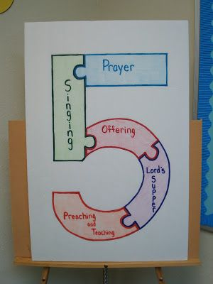
Worship
Acts 2:42 – “They were continually devoting themselves to the apostles’ teaching and to fellowship, to the breaking of bread and to prayer.”
Lord’s Supper
Matt 26:26-29; 1 Cor 10:16; 11:23-30; Acts 20:7
Contribution
1 Cor 16:1-2; 2 Cor 9:7
Singing
Col 3:16; Eph 5:19; 1 Cor 14:15-17
Prayer
1 Tim 2:1-2, 8; Phil 4:6
Preaching
Matt 28:20; Acts 2:42; Acts 20:7b
Notes:
That the first century Christians regularly got together for fellowship is undeniable. As Acts 2:42 reveals, they continually devoted themselves to the apostles’ teaching, fellowship, breaking of bread, and prayer. The bible provides for us several patterns and instructions for how specifically God wants us to worship in truth:
First, Jesus instituted the Lord’s Supper and we see that in the first century Christians partook of this supper weekly (Acts 20:7). Therefore, any church that is modeled after the New Testament teaching must do the same.
Secondly, Christians in the first century were instructed to give of their monetary means on a weekly basis. This is what was taught to all churches by Paul. And though this instruction was a for a specific need of the day, needs continue to exists for which the money was intended. Therefore the command remains the same.
Third, Christians are commanded to sing hymns and these hymns are to encourage and admonish one another. No instruction regarding instrumental music is given and therefore cannot be assumed; therefore it is not authorized.
Fourth, disciples come together to prayer; this would be prayers directed to God and for one another as well as any need of the moment. Collective prayer is the gateway toward enlisting God’s providential and divine care for our lives in every aspect.
Fifth, Christians of the first century came together for teaching and preaching of God’s word. This was generally done by evangelists and preachers.

Slide 16
Work
Eph 4:11-16 – “And He gave some as apostles, and some as prophets, and some as evangelists, and some as pastors and teachers, for the equipping of the saints for the work of service, to the building up of the body of Christ; until we all attain to the unity of the faith, and of the knowledge of the Son of God, to a mature man, to the measure of the stature which belongs to the fullness of Christ. As a result, we are no longer to be children, tossed here and there by waves and carried about by every wind of doctrine, by the trickery of men, by craftiness in deceitful scheming; but speaking the truth in love, we are to grow up in all aspects into Him who is the head, even Christ, from whom the whole body, being fitted and held together by what every joint supplies, according to the proper working of each individual part, causes the growth of the body for the building up of itself in love.”
Notes:
Lastly, the new testament church can be identified by its work. In other words, there are things God would have local churches to do with one another and throughout the community. The description of the church as a body is the best description of the church that aptly explains this aspect of its role before God. As a body, the church is made of individual members who have various talents that are used to contribute to the overall work. This work aids in building up God’s church, equipping its members for the ministry, and for works of service. This work helps us to be more and more like Jesus in every aspect of His character so that we will mature behind spiritual infancy. Every member of the body is essential to the growth of the church through its work and the local church will only be as strong as its weakest member.

Slide 17
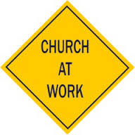
Work
Evangelism: Spreading the gospel
1 Tim 3:14-15; 1 Thes 1:6-8; 2 Thes 2:14-15; Rom 1:16; Acts 8:4
Edification: Build up one another
Heb 3:12-14; 10:24-25; Col 3:16; Eph 5:19; 4:16
Benevolence: Goodwill, charity
2 Cor 8:1-4; 9:1-2; 1 Tim 5:16; Acts 4:32-37; 11:29-30; 1 Cor 16:1; Rom 15:26
Notes:
The New Testament mentions 3 general areas of work which additionally helps us identify it
First, the New Testament local church is responsible for evangelism. That is, we are responsible for bringing the message of Jesus Christ to our communities and encouraging people to obey the gospel. Though evangelists and preachers are men who have designated their lives to fulfilling this aspect of the work, every member as a part to play. In a sense, we are all evangelists who are responsible for shining our lights and pointing people to Jesus through our influence and teaching.
Second, the New Testament local church is responsible for edification. This is the idea of encouraging one another, building one another up, and equipping one another to do and be the best Christians possible. This involves every member understand that we are not assembling merely for ourselves, but for others. “Church” is not somewhere we go. It is who we are. And our job is to stimulate one another to love and good deeds.
Third, we have an obligation to care for needy saints. This certainly includes monetary care but would also include benevolent acts of service and charity. Though we are responsible for doing good to all men, it should be noted that the collection of the local church itself should only be designated for saints.

Slide 18
Schedule
First Quarter
Second Quarter
Why Study Church History?
Origin of the Lord’s Church
Post-Apostolic Apostasy
Post-Apostolic Persecution
Edict of Milan & Aftermath
Fall of Rome
Rise of Islam
The Holy Roman Empire
Catholicism vs. The Bible
Reformation
Presbyterian Church
Church of England
Baptist Church
Methodist Church
Holiness Movement
Mormonism
Jehovah’s Witnesses
Restoration

